Slide 1

IPL Data Analysis
Power BI

Slide 2
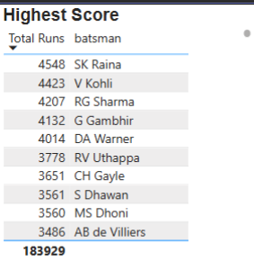
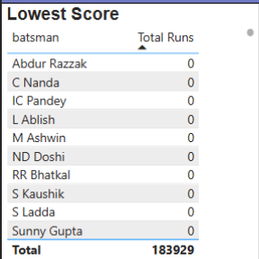
Highest and Lowest Scorers in the IPL

Slide 3
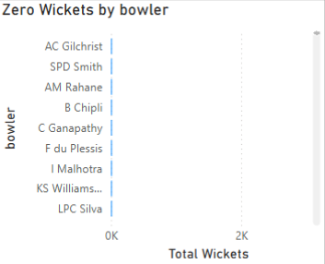
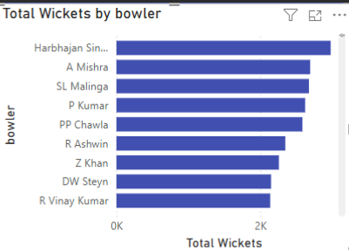
Bowlers with the Most Wickets & Those with Zero Wickets

Slide 4
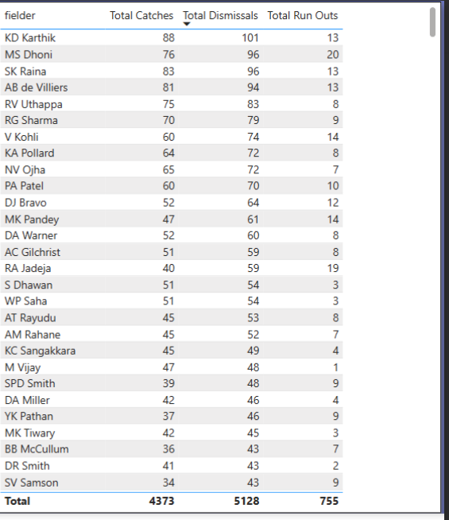
Top Fielders Based on Catches & Run-Outs

Slide 5
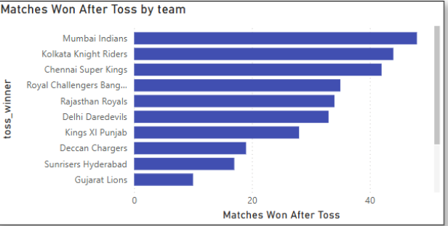
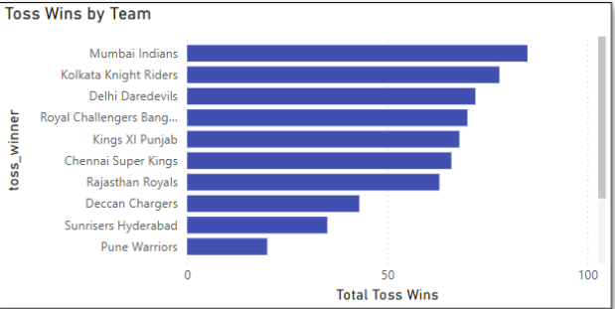
Number of Tosses Won by Each Team & Match Winners After Winning Toss

Slide 6
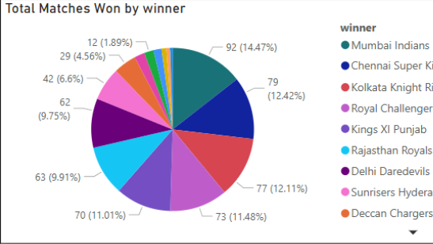
Most Successful IPL Teams

Slide 7
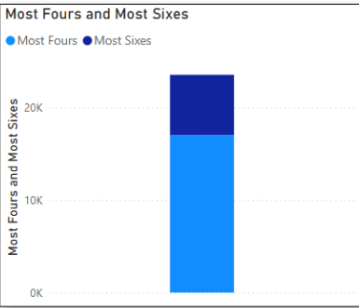
Most Sixes & Fours by Individuals & Teams

Slide 8
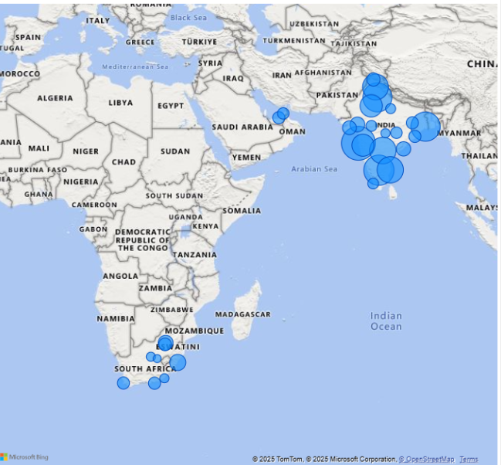
Number of Matches Hosted by Different Cities

Slide 9
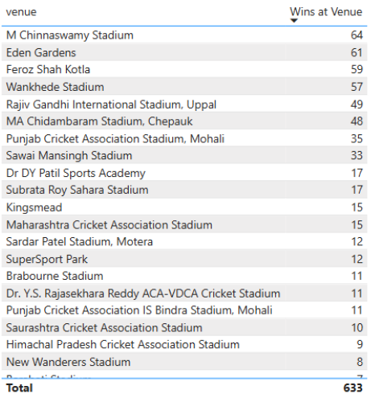
Lucky Stadium for the Top Team

Slide 10
Recommendations
Focus on
Focus on strong players & strategies.
Optimize
Optimize team decisions based on toss trends.
Leverage
Leverage venue advantages for key matches.

Slide 11

Thank you

